Slide 1
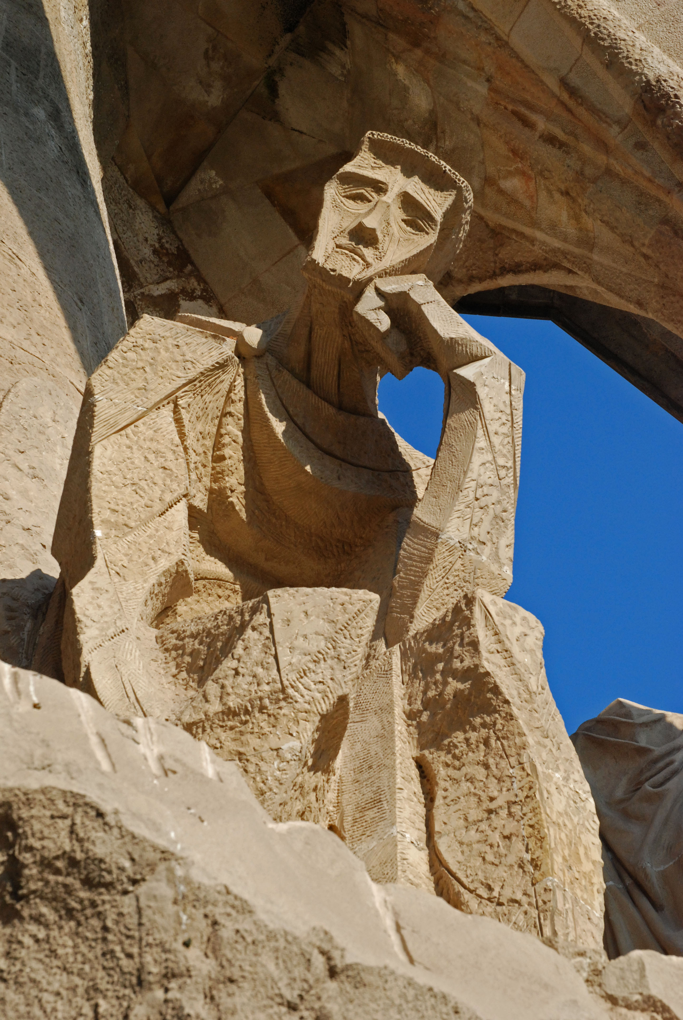
Architectures of Intelligence Lecture 7 Procedural Memory

Slide 2
Manual
Control
Visual
Perception
Procedural Memory
Declarative
Memory
WM: Imaginal
Control: Goal

Slide 3
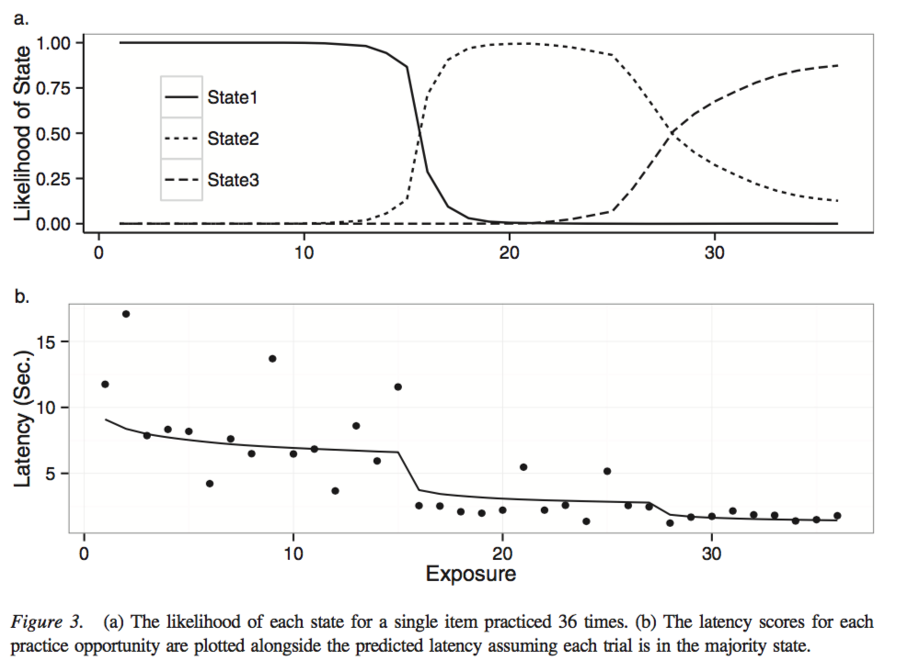
Today
Skill acquisition and production rules
Procedural Memory & Utility Learning
Learning new rules: Production Compilation
Black Jack Assignment

Slide 4
4 $ 2 = ?

Slide 5
Task: Pyramid Problems
base $ height = value
4 $ 2 = 7
4 $ 2 = 4 + 3 = 7
9 $ 5 = 9 + 8 + 7 + 6 + 5 = 35

Slide 6
5 $ 3 = ?
5 $ 3 = 5 + 4 + 3 = 12
Notes:
36 repetitions

Slide 7
6 $ 2 = ?
6 $ 2 = 6 + 5 = 11
Notes:
36 repetitions

Slide 8
5 $ 3 = ?
5 $ 3 = 5 + 4 + 3 = 12
Notes:
36 repetitions

Slide 9
4 $ 4 = ?
4 $ 4 = 4 + 3 + 2 + 1 = 10
Notes:
36 repetitions

Slide 10
5 $ 3 = ?
5 $ 3 = 5 + 4 + 3 = 12
Notes:
36 repetitions

Slide 11
7 $ 3 = ?
7 $ 3 = 7 + 6 + 5 = 18
Notes:
36 repetitions

Slide 12
5 $ 3 = ?
5 $ 3 = 5 + 4 + 3 = 12
Notes:
36 repetitions

Slide 13
6 $ 2 = ?
6 $ 2 = 6 + 5 = 11
Notes:
36 repetitions

Slide 14
5 $ 3 = ?
5 $ 3 = 5 + 4 + 3 = 12
Notes:
36 repetitions

Slide 15
36 repetitions…
… vs. novel problems
Tenison & Anderson, 2015
Tenison, Fincham, & Anderson, 2016
Notes:
36 repetitions

Slide 16
Is there evidence for discrete learning phases, or is it just a gradual speedup?
How many learning phases?
Tenison & Anderson, 2015
Tenison, Fincham, & Anderson, 2016
Notes:
Turns out height 4 is harder to remember (amazon turk study). Don’t mention, unless they ask.

Slide 17
How many learning phases?
Tenison et al. fit Hidden Markov Models to the response time data:
1-8 learning phases
different types of learning within a state (none, power, exponential, and complex)
Winner: 3 learning phases with power law speedup
Notes:
Besides a no-learning model (that had no within-state speedup), we tested three different functions to describe within-state speedup: a three-parameter power function, a three-parameter exponential function, and the four- parameter APEX function.

Slide 18
Example: repeated item
Notes:
Some ambiguity at stage transitions

Slide 19
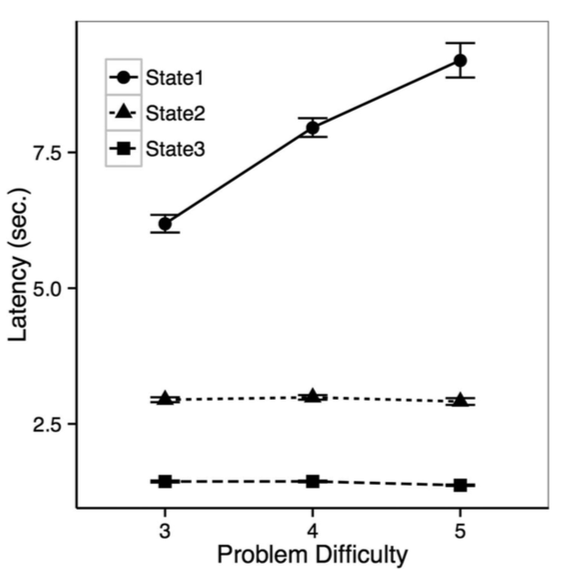
What are these three phases?
fMRI shows three stages within the learning phases
Phase 1
Phase 2
Phase 3
computation
retrieval
?

Slide 20
fMRI shows three stages within the learning phases
Phase 1
Phase 2
Phase 3
computation
retrieval
?

Slide 21
fMRI shows three stages within the learning phases
Phase 1
Phase 2
No declarative retrieval in learning phase 3!
Phase 3
computation
retrieval
?

Slide 22
ACT-R Model
Response is given by procedural memory!
Notes:
We will now describe the details of the ACT-R processing in each of these learning phases.1.Learning phase 1: The model for Learning phase 1 is the minimal adaption of the model in Anderson and Fincham (2014b) (Fig. 1) to correspond to the current task. Only three characters are presented, rather than the five in Anderson and Fincham (2014b), and so the visual encoding is reduced. On the other hand, we assume that during the Encoding stage participants check problems to see if they have a stored answer. The long retrieval in the Encoding stage reflects the failed effort to retrieve an answer. The Solving stage has identical structure to Anderson and Fincham. The Responding stage differs from Anderson and Fincham only in that there is an additional key press to begin the keying of the answer.
2.​Learning phase 2: The major difference between Learning phase 1 and Learning phase 2 is that the answer is retrieved and there is no need for a Solving stage. The Encoding stage is briefer because the retrieval process succeeds in this stage before it would have timed out in Learning phase 1. In addition, we assume that the participants now skip the encoding of the dollar-sign operator, and rather just encode base and height. In contrast to what might be concluded from the analysis in Fig. 8, there is no shortening of the Responding stage in the model.
3.​Learning phase 3: In the third learning phase, the problem is recognized as a single unit and a production maps this onto the response, resulting in a very short Encoding stage. The Responding stage is a bit faster because there are no longer visual checks of whether the correct keys are actually struck.

Slide 23
Phases of Skill Acquisition
Three phases of skill acquisition:
Fitts & Posner (1967)
Cognitive
Associative
Autonomous
ACT-R (e.g., Tenison & Anderson, 2015)
Declarative - computation
Declarative - retrieval
Procedural - reflex-like
How do we recognize such phases?
Indicated by discontinuities: “sudden jumps” and “U shapes”
Notes:
Procedural: automatic and implicit, fast and few errors -> you have difficulties to verbalize them (e.g. Johns example of typing without “knowing” where the keys are; if you think about what you are doing, you start making mistakes)

Slide 24
Why is there a procedural phase?
Declarative knowledge
Retrieval is time-consuming and error-prone
Procedural knowledge
Can be executed at (almost) no costs and low risk for error
Notes:
But there can be overgeneralizations!
Note that the same information can be represented in chunks as in rules (e.g. 2+3=5)
Both representations have their advantages
Give pyramids examples

Slide 25
Declarative vs. Procedural
Declarative knowledge
Retrieval is time-consuming and error-prone
Is often specific (e.g., 5 $ 3 = 12)
Can be articulated
Procedural knowledge
Can be executed at (almost) no costs and low risk for error
Is often general (e.g., b $ h = b + (b-1) + … =)
Unless it is a highly trained task, then it is very specific (5$3 => 12)
Is typically ’unconscious’
Notes:
But there can be overgeneralizations!
Note that the same information can be represented in chunks as in rules (e.g. 2+3=5)
Both representations have their advantages
Give pyramids examples

Slide 26
Three phases of Skill Acquisition
5 $ 3 = ?
Phase:
Cognitive
Associative
Autonomous
instance-based learning
computation
production compilation + utility learning
retrieval
procedural
memory activation related to retrieving count facts
(5+4=9, 9+3=12)
memory activation related to the answers directly
(5$3=12)
no memory activation
Notes:
Some ambiguity at stage transitions

Slide 27
Today
Skill acquisition and production rules
Procedural Memory & Utility Learning
Learning new rules: Production Compilation
Black Jack Assignment

Slide 28
Production Utility in ACT-R
Utility = Expected Reward of a Rule, discounted by time until the reward
This can be explicitly set by the modeler
Or learned over time by the model
(spp name-of-a-production-rule :u 10)
t=0
t=0.5
t=2
t=4
Rule 1
Rule 2
Rule 3
Rule 4
Utility 6
Utility 6.5
Utility 8
Utility 10
Reward 10
Notes:
Uni 6 in the tutorial
Spp: set production parameter
If no utility value is assigned to a production, it is be default 0
The reward Ri(n) that production i will receive will be the external reward received minus the time from production i’s selection to the reward.

Slide 29
Utility is used for conflict resolution
The rule with the highest utility has the highest probability to be selected
Utility of rule i
Noise :egs
All productions k that currently match
Notes:
Utility determines the probability of selecting a rule

Slide 30
Example: Probability matching
In the next ten slides, you will see two buttons.
Select one of these buttons:
If you have selected the correct button, you will receive a “reward”, otherwise nothing

Slide 31
Choose a button
A
B

Slide 32
A
B
Nothing
Reward!

Slide 33
Choose a button
A
B

Slide 34
A
B
Nothing
Reward!

Slide 35
Choose a button
A
B

Slide 36
A
B
Reward!
Nothing

Slide 37
Choose a button
A
B

Slide 38
A
B
Reward!
Nothing

Slide 39
Choose a button
A
B

Slide 40
A
B
Nothing
Reward!

Slide 41
Choose a button
A
B

Slide 42
A
B
Nothing
Reward!

Slide 43
Choose a button
A
B

Slide 44
A
B
Nothing
Reward!

Slide 45
Choose a button
A
B

Slide 46
A
B
Nothing
Reward!

Slide 47
Choose a button
A
B

Slide 48
A
B
Reward!
Nothing

Slide 49
Choose a button
A
B

Slide 50
A
B
Reward!
Nothing

Slide 51
What was the best button?
A
B
30% probability of reward
(4 were reward)
70% probability of reward
(6 were reward)
What will participants do in such an experiment?
Notes:
Due to random draws from the probability distribution, the exact number an option is selected is not necessarily equal to the probability

Slide 52
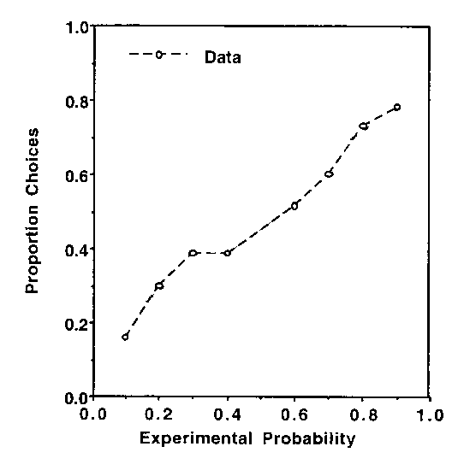
Results of Friedman et al. (1964)
Participants do “probability matching”
→ They converge to a certain percentage of choosing an option, depending on the probability of finding the reward there
Small probabilities are “overweighed”
Proportion of choices for option A
Experimental probability of reward in option A
Notes:
Which of the lights comes on? The probabiliy of the right light changed over the course of the experiment

Slide 53
A model of probability matching
Two (competing) production rules:
Press button A
Press button B
Utility = 0.3
What is the probability of selecting rule A?
If s=.0001
If s=.1
If s=.2
If s=.5
If s = 100
30%: Reward 1
70%: Reward 0
Press A
p<.001
p=.3
p=.35
Press B
70%: Reward 1
30%: Reward 0
p=.4
p=.5
Utility = 0.7
Notes:
If noise is close to zero, the probablity for rule A will be essentially 0
If noise is .1, the probablity for rule A will be close to .3!
If noise is .2, the probablity for rule A will be .35!
If noise is .5, the probablity for rule A will be .4!
Here the probabilities do at up to 1, because the probability of one rule depends on the utility of this rule relative to all other matching rules
While with for activations in dm, p depends on the activation of a chunk relative

Slide 54
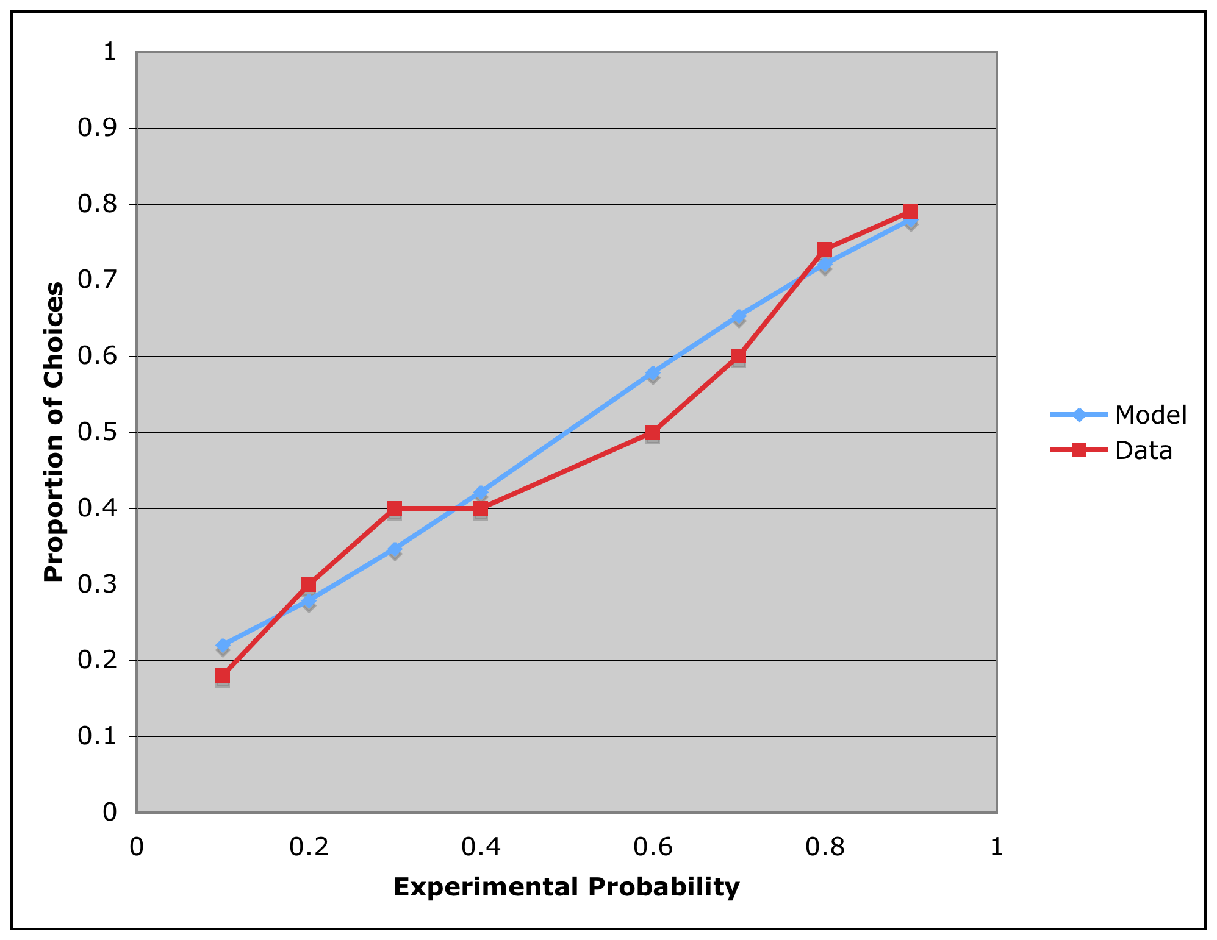
Results of the model
Model fit
with s=0.2
Proportion of choices for option A
So how does the model explain the “overweighting” of small probabilities?
Experimental probability of reward in option A
Notes:
Model in unit 6
Overweighting of small probabilities due to noise

Slide 55
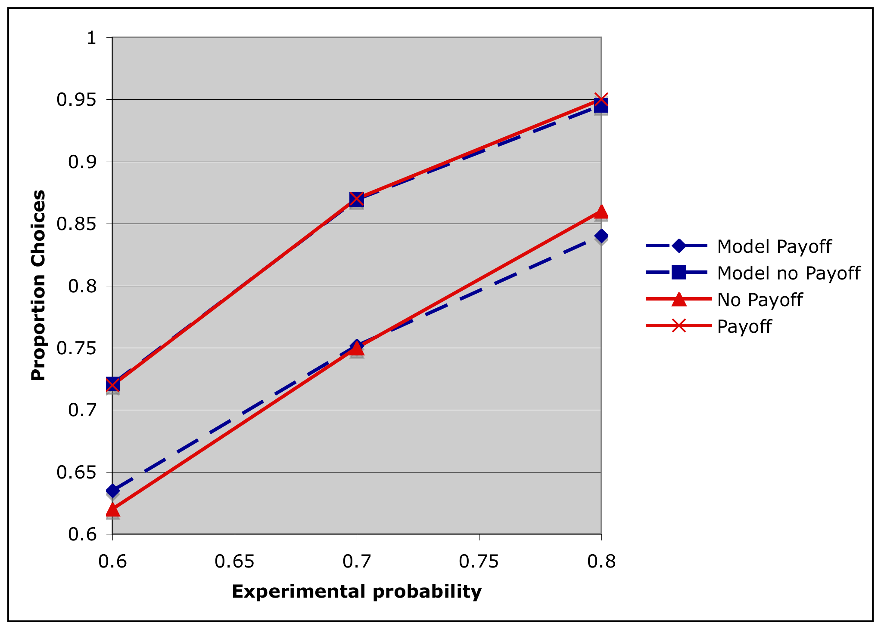
What happens when you increase the reward to 10 cents?
10 cent payoff
Proportion of choices for dominant option
no payoff
Experimental probability of reward in the dominant option
ACT-R model: reward increases (and consequently the utility)

Slide 56
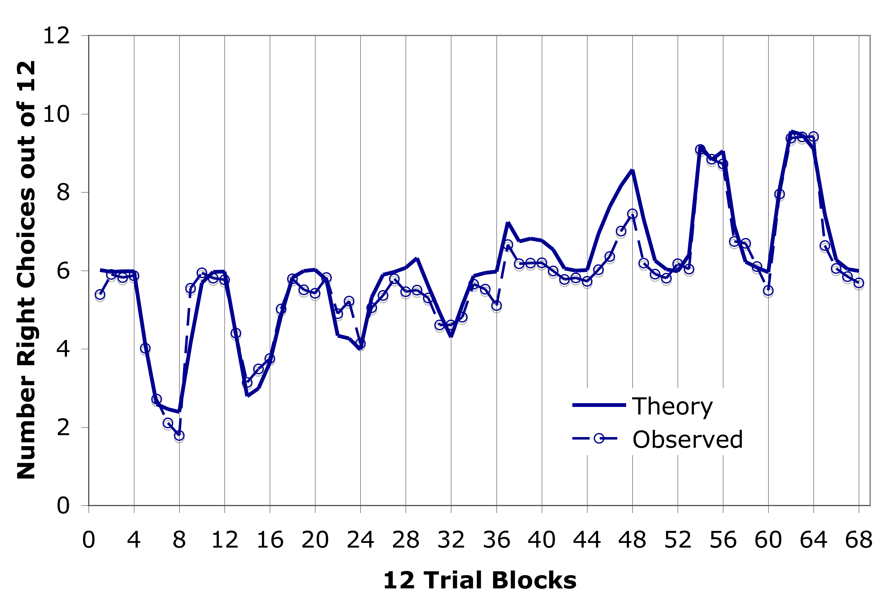
What happens when we vary the rewards?
Proportion Right
Button Correct
.9
.8
.7
.6
.4
.3
Model
.2
.1
Notes:
In odd blocks the probability was .5, in even blocks the probability varied between .1 and .9, for the right button to be correct
The only parameter that was fitted in this model was the reward! (Set to
2)
There were 48-trial blocks, the x-axis indicates 12-trial blocks. Odd/even refers to the 48-trial blocks. Anderson, 2007, p165.

Slide 57
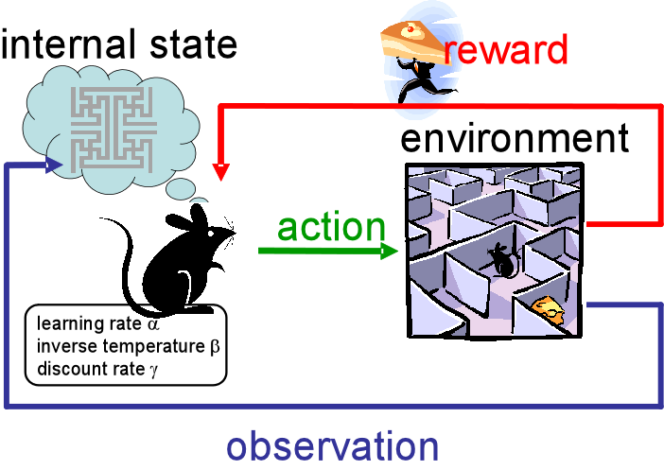
How are utilities learned?
Reinforcement Learning
Notes:
Utility Learning in ACT-R used to have its own idiosyncratic mechanism
But has now adapted the popular mechanism of reinforcement learning
Based on the reward that an action receives (observed or actual), the internal state is updated to make the execution of that action in the future more or less likely

Slide 58
Reinforcement Learning
Rule 1
Rule 2
Rule 3
Rule 4
V=0
V=0
V=0
V=0
Reward 10

Slide 59
Reinforcement Learning
Learning is controlled by a learning rate alpha
alpha = 1
Rule 1
Rule 2
Rule 3
Rule 4
V=0
V=0
V=0
V=10
Reward 10
Notes:
If a rule fires that is connected to a reward, that rule gets the reward
If alpha is 1, a reward of 10 would lead to a value of 10

Slide 60
Reinforcement Learning
Learning is controlled by a learning rate alpha
Temporal Discounting is controlled by a discounting parameter gamma
alpha = 1
gamma = .8
Rule 1
Rule 2
Rule 3
Rule 4
V=0
V=0
V=8
V=10
Temporal
Discount
Reward 10
Notes:
The next time around, the rule that precedes the one that was rewarded also gets a reward, but this reward gets a temporal discount
If gamma is .8, a previous rule gets a reward of the next rule*.8

Slide 61
Reinforcement Learning
Learning is controlled by a learning rate alpha
Temporal Discounting is controlled by a discounting parameter gamma
alpha = 1
gamma = .8
Rule 1
Rule 2
Rule 3
Rule 4
V=5.12
V=6.4
V=8
V=10
Reward 10
Notes:
Reward of the next step * temporal discount
8*.8=6.4
6.4*.8=5.12

Slide 62
Problem of reinforcement learning
In situations with multiple steps RL is often too slow to match human data
→ ACT-R uses a simplified version of the RL mechanism
Rule 1
Rule 2
Rule 3
Rule 4
Round 4:
V=5.12
Round 3:
V=6.4
Round 2:
V=8
Round 1:
V=10
Reward 10

Slide 63
Utility learning in ACT-R
Some productions are associated with a reward
Reward for production i: external reward minus the time from production i’s selection to the reward
t=0
t=0.5
t=2
t=4
Rule 1
Rule 2
Rule 3
Rule 4
Reward 6
Reward 6.5
Reward 8
Reward 10
Notes:
10-2=8
10-3.5=6.5
10-4=6

Slide 64
Utility learning in ACT-R
Learning rate :alpha
Reward at application n
utility at application n-1
difference between current utility and reward
Notes:
LEARNING RATE ALPHA, TYPICALLY .2
This is also basically the Rescorla-Wagner learning rule (Rescorla & Wagner, 1972). According to this equation the utility of a production will be gradually adjusted until it matches the average reward that the production receives.
If alpha was above 1, rewards would be overweighted!

Slide 65
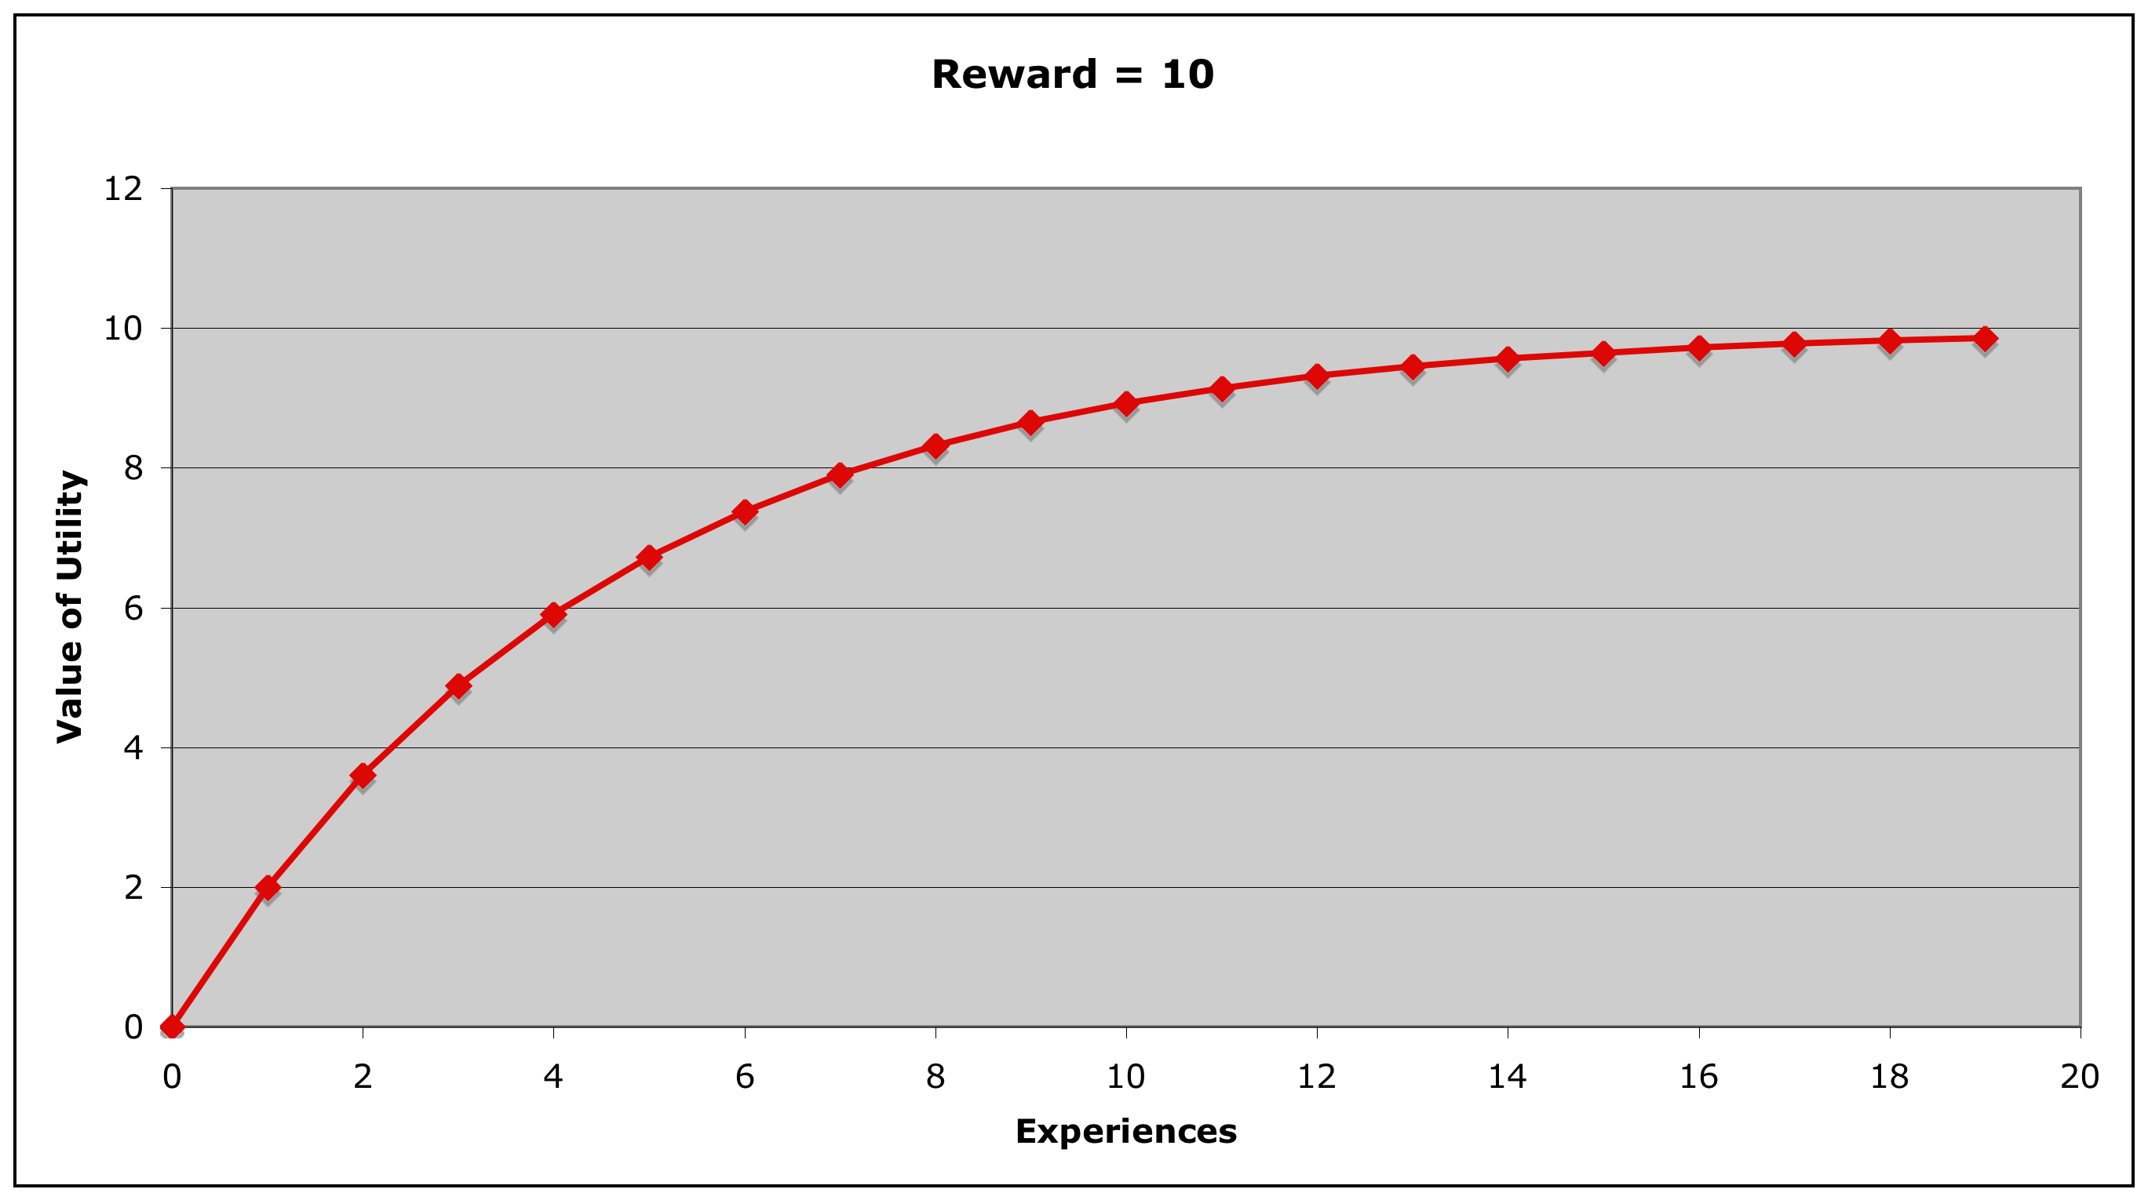
Over time, the utility of a production will be gradually adjusted until it matches the received average reward
α=.2
Biologically plausible?
Yes: dopamine codes difference between expected and actual rewards, changes pattern matching in BG
Notes:
Learning rate of .2
10*.2
2+.2(10-2)
Utility of a rule will be gradually adjusted until it matches the received average reward

Slide 66
What does the model look like?
A
B
30% probability of reward
(4 were reward)
70% probability of reward
(6 were reward)
Notes:
Due to random draws from the probability distribution, the exact number an option is selected is not necessarily equal to the probability

Slide 67
Choice Rules
(p choose-A
=goal>
ISA choose
state attending
=visual>
isa text
value "choose"
?manual>
state free
==>
=goal>
item ”A"
state nil
+manual>
ISA press-key
key ”A")
(p choose-B
=goal>
ISA choose
state attending
=visual>
isa text
value "choose"
?manual>
state free
==>
=goal>
item ”B"
state nil
+manual>
ISA press-key
key ”B")

Slide 68
Rewards
(p reward
=goal>
ISA choose
state attending
=visual>
isa text
value ”Reward”
==>
+goal>
isa choose)
(p no-reward
=goal>
ISA choose
state attending
=visual>
isa text
value “Nothing”
==>
+goal>
isa choose)
(spp reward :reward 2) (spp no-reward :reward 0)

Slide 69
Results in more detail
Proportion Right
Button Correct
.9
.8
.7
.6
.4
.3
.2
.1
Notes:
In odd blocks the probability was .5, in even blocks the probability varied between .1 and .9
The only parameter that was fitted in this model was the reward! (Set to 2)

Slide 70
Today
Skill acquisition and production rules
Procedural Memory & Utility Learning
Learning new rules: Production Compilation
Black Jack Assignment

Slide 71
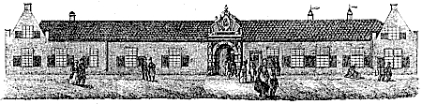
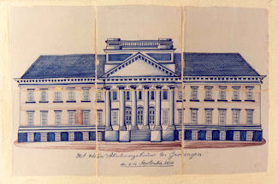
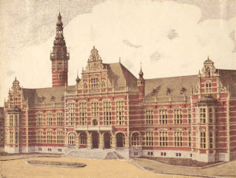
The Past Tense Debate
1614
1850
1909
Notes:
Classic debate in cognitive science
One of the cornerstones of connectionism
An example of real-world long-term learning

Slide 72
Learning the English Past Tense
Stage 1: talk – talked bring-brought
Stage 2: talk – talked bring-bringed
Stage 3: talk – talked bring-brought
100%
Prop.
correct
The Debate:
Symbolic Rules vs. Connectionist Network
Age
Notes:
Classic debate in cognitive science
One of the cornerstones of connectionism
An example of real-world long-term learning
Symbolicists: learning rules vs connectionists: growing vocabs
Stage 1: irregluar verbs are used correctly
Stage 2: child starts to understand the regularities in forming the past tense -> will sometimes generate “regular” past-tenses of irregular verbs
Transition from stage 2 to 3 takes several years

Slide 73
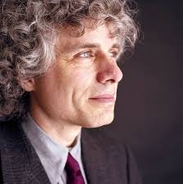
Symbolic theory (e.g. Pinker & Prince, 1988)
Regular verbs are represented by a rule
Irregular verbs are memorized
The onset of the U-shape coincides with the learning of the “regular” rule
Overgeneralization must be the result of rule learning, because children could not have learned incorrect past tenses from experience
play → played
break → broke
break → breaked
Notes:
Argument: Overgeneralization must be a result of rule learning, as children could not have learned the incorrect past-tense of irregular verbs from experience

Slide 74
Symbolic theory (e.g. Pinker & Prince, 1988)
Stage 1: break-broke
Stage 2: break-breaked
Stage 3: break-broke
100%
Successful retrievals result in correct answers, failed retrievals in no answer
All retrievals are successful
Prop.
correct
Successful retrievals result in correct answers, failed retrievals in application of the rule (-ed)
Age
Notes:
This theory does not explain false irregularizations

Slide 75

Two problems with the Symbolic theory
How is the rule discovered?
Does not explain wrong overregularization (e.g. bring-brang)
Notes:
Argument: Overgeneralization must be a result of rule learning, as children could not have learned the incorrect past-tense of irregular verbs from experience

Slide 76


Connectionist Theory (e.g., Rumelhart & McClelland, 1986)
All knowledge is represented in a neural network
U-shaped learning is explained by the growth of the vocabulary

Slide 77
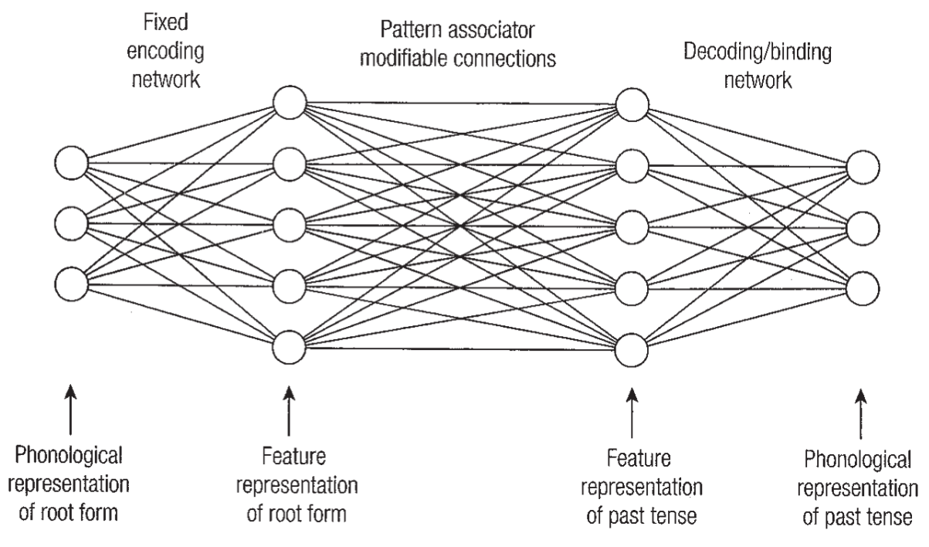
The Rumelhart and McClelland Model (1986)
kic
kic
ick
ick
kick
kicked
cke
ked
Notes:
Model was trained with 420 pairs of root verbs with their past tense
2 basic parts of the model:
pattern associator network (learns relationship between base form and past-tense form)
- decoding network (converts feature representation of the past-tense form into a phonological representation)

Slide 78
Feature representation in the neural network
ork
Words are represented by phonetic “Wickelfeatures”
Break becomes:
bre
rea
eak
wor
bre
bre
rea
rea
Output
Input
eak
eak
wor
ake
ork
ked
Notes:
Wickelfeature (Wickelgren , 1969): each phone (sound – phonetic feature) in a word is represented as a triple, consisting of the phone and its predecessor and successor
Input units: represent the input pattern corresponding to the root form of the verbs
Output units: output generated as current guess about the past tense

Slide 79
Feature representation in the neural network
Input activation
Output activation
weight
Learning sink/sank
sin
sin
ink
ink
san
san
ank
ank
win
win
nke
nke
ked
ked
Notes:
Input weights are set to 1 -> Model calculates the output weights (input units * weight)
Then the model receives feedback and adjusts the connection strengths so that they would produce the correct output

Slide 80
Feature representation in the neural network
Input activation
Output activation
Learning sink/sank
sin
weight
sin
ink
ink
san
san
ank
ank
win
win
nke
nke
ked
ked
Notes:
Input weights are set to 1 -> Model calculates the output weights (input units * weight)
Then the model receives feedback and adjusts the connection strengths so that they would produce the correct output

Slide 81
Feature representation in the neural network
Learning sink/sank
and wink/winked
sin
sin
ink
ink
san
san
ank
ank
win
win
nke
nke
ked
ked
Notes:
The input feature ink is now not only used for sink but also for wink

Slide 82
Feature representation in the neural network
What is the past tense of sink?
sin
sin
ink
ink
san
san
ank
ank
win
win
nke
nke
ked
ked

Slide 83
Feature representation in the neural network
What is the past tense of sink?
This still works, but suppose we also learn
sin
sin
ink
ink
san
san
ank
ank
win
win
nke
nke
ked
ked
Notes:
initially the neural network is able to accommodate all individual examples,
but as the size of the vocabulary increases, the network is forced to generalize, producing decreased performance on irregular
verbs.

Slide 84
Feature representation in the neural network
What is the past tense of sink?
This still works, but suppose we also learn
blink-blinked
sin
sin
ink
ink
san
san
ank
ank
win
win
nke
nke
ked
ked

Slide 85
Feature representation in the neural network
What is the past tense of sink?
This still works, but suppose we also learn
blink-blinked
stink-stinked
sin
sin
ink
ink
san
san
ank
ank
win
win
nke
nke
ked
ked

Slide 86
Feature representation in the neural network
What is the past tense of sink?
This still works, but suppose we also learn
blink-blinked
stink-stinked
sin-sinned
sin
sin
ink
ink
san
san
ank
ank
win
win
nke
nke
ked
ked

Slide 87
Feature representation in the neural network
Then all kinds of combinations can win:
sink-sinked
sink-sank
sink-sanked
sin
sin
ink
ink
san
san
ank
ank
win
win
nke
nke
ked
ked

Slide 88
Results of the network
% Correct
Dip in performance when there are too many new words – correct and incorrect forms receive activation
Practice
No rules, just retrievals!
Notes:
Dip in performance when there are too many new words – correct and incorrect forms receive activation
Increase in performance over time, as the correct forms get reinforced
So this model works without assuming any use of rules

Slide 89

Problems with the connectionist theory
Relies on a sudden increase in vocabulary
10 => 420 items
But there is little evidence that growth of vocabulary and overregularization coincide in children
Produces (too) many types of errors
Only works when regular verbs are a majority
Notes:
This is true for the original model, but also largely for more advanced newer neural network models
Sudden incrase: 10 items to 420 items

Slide 90
Why is there a distinction between regular and irregular verbs in the first place?
Regular verbs:
Advantage: very productive (only one rule is needed)
Disadvantage: tend to be longer (-ed needs to be added)
Irregular verbs:
Advantage: almost always shorter, so faster to pronounce
Disadvantage: have to be memorized
Low frequency
High frequency
Suppose you had to design your own language, how would you make use of the respective advantages?
Notes:
According to rational analysis, each component of the cognitive system is optimized with respect to demands from the environment, given its computational limitations.

Slide 91
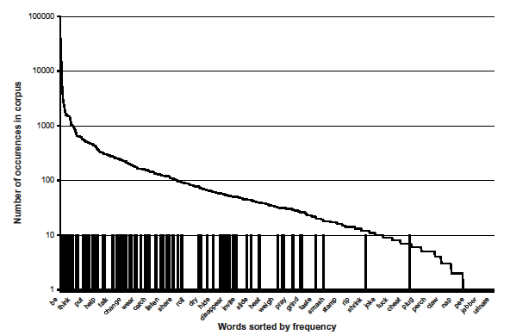
Frequency in English
Frequencies of 478 verbs used by children or their parents (Marcus et al., 1992)
Notes:
Curve: number of occurrences in the corpus
Bars: irregular verbs
Though most English verbs are regular verbs, irregular verbs are the more frequently used ones.
→ 25-30% of all used verbs are regular

Slide 92
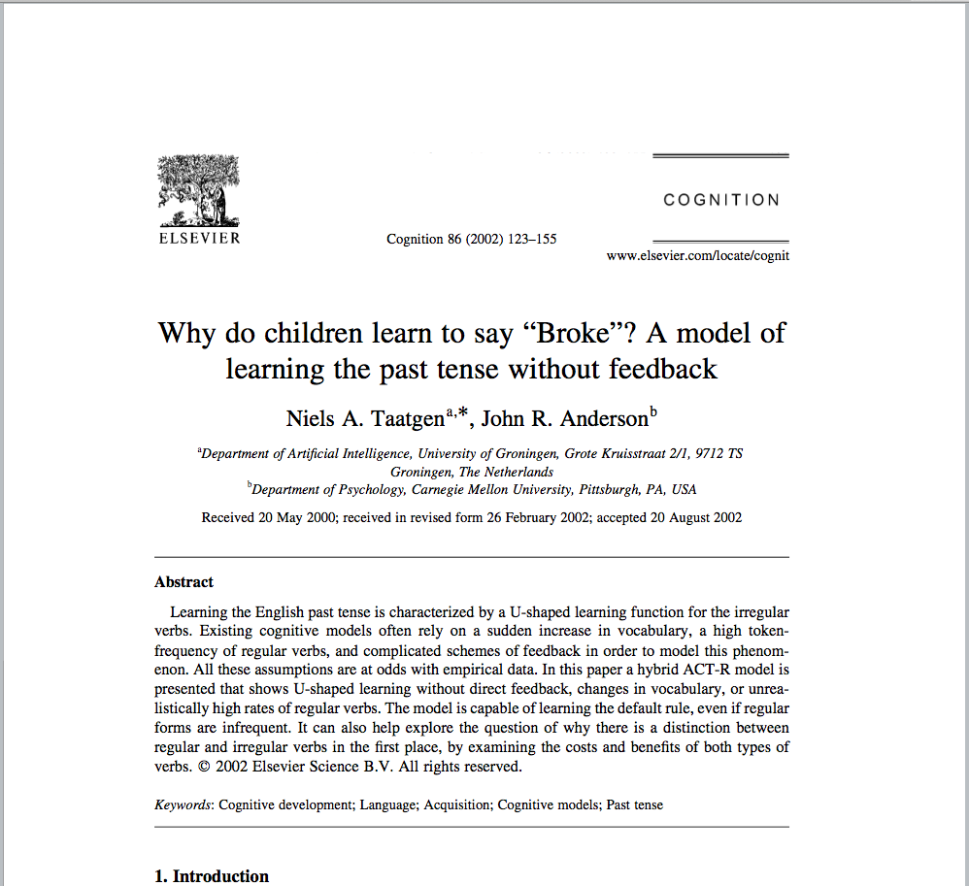
An alternative hybrid model in ACT-R (Taatgen & Anderson, 2002)
Notes:
Cited 350 times (2022)

Slide 93

Key elements of the ACT-R model
Based on the idea of procedural learning
Model learns
From hearing others use the past-tense
And from generating the past-tense itself
Encounters words in their true real-world frequency
Requires no feedback

Slide 94
Input to the model
The model has to produce a past tense for a verb every 2000 seconds
For every produced past tense, it perceives two new verbs and their past tense → Stored in declarative memory
Verbs are drawn from the Marcus et al. (1992) corpus
478 verbs used by children
100 of which are irregular
The probability that a certain verb is selected is based on the frequency in the corpus
→ irregular verbs have an advantage: faster to pronounce, higher reward

Slide 95
Declarative Memory
Environment (i.e., parents)
work
work
ed
go
break
went
broke
break
break
ed
Current goal
break
?
?

Slide 96
Declarative Memory
Environment (i.e., parents)
One initial strategy:
Retrieval
work
work
ed
1. Successful retrieval
go
Can lead to correct or wrong answer, based on what has been learned before
break
went
broke
break
break
ed
Current goal
break
?
?

Slide 97
Declarative Memory
Environment (i.e., parents)
One initial strategy:
Retrieval
work
work
ed
1. Successful retrieval
2. Retrieval failure
go
went
Use the present tense
Current goal
break
?
ed
?

Slide 98
Declarative Memory
Environment (i.e., parents)
One initial strategy:
Retrieval
work
work
ed
1. Successful retrieval
2. Retrieval fails
3. Something else is retrieved
go
went
Make an analogy
Current goal
work
work
ed
break
?
ed
?
Notes:
overgeneralization

Slide 99
Declarative Memory
Environment (i.e., parents)
sing
sang
1. Successful retrieval
2. Retrieval fails
3. Something else is retrieved
go
went
Make an analogy
Current goal
sing
sang
bring
?
?
brang
Notes:
Wrong irregularization

Slide 100
Rule learning: the regular rule is learned by repeatedly applying the analogy strategy
Retrieval rule
Use-analogy rule
Retrieve example
for walk
Apply pattern in example to current case
Paste tense of
work is work-ed
Fact from DM
production compilation
Retrieve example
Apply pattern in example to current case
Paste tense of
walk is walk-ed
Procedural
Declarative

Slide 101
Rule learning: the regular rule is learned by repeatedly applying the analogy strategy
Retrieval rule
Use-analogy rule
Retrieve example
for walk
Apply pattern in example to current case
Paste tense of
work is work-ed
Fact from DM
New compiled rule
Add -ed to stem
Procedural
Declarative

Slide 102

Production compilation
General idea: two rules that fire in sequence are combined into one new rule
Rule 1
Rule 2
Fact
Rules are specialized by factoring out the retrieval request and retrieval match
New rule
Notes:
General idea: two rules that fire in sequence are combined into one new rule
Production rules are specialized by factoring out the retrieval request and retrieval match (if any, otherwise there is no specialization)

Slide 103
Production compilation
(p apply-analogy
=goal>
isa goal
state retrieving
=imaginal>
isa past-tense
verb =stem
=retrieval>
isa past-tense
verb =word
stem =word
suffix =suffix
==>
=imaginal>
stem =stem
suffix =suffix
=goal>
state done)
(p retrieve
=goal>
isa goal
state start
=imaginal>
isa past-tense
verb =stem
stem =stem
suffix nil
==>
+retrieval>
isa past-tense
=goal>
state retrieving)
word324
isa past-tense
verb work
stem work
suffix ed

Slide 104
Production compilation
(p learned-rule
=goal>
isa goal
state start
=imaginal>
isa past-tense
verb =stem
stem =stem
suffix nil
==>
=imaginal>
stem =stem
suffix ed
=goal>
state done)
(p retrieve
=goal>
isa goal
state start
=imaginal>
isa past-tense
verb =stem
stem =stem
suffix nil
==>
+retrieval>
isa past-tense
=goal>
state retrieving)
(p apply-analogy
=goal>
isa goal
state retrieving
=imaginal>
isa past-tense
verb =stem
=retrieval>
isa past-tense
verb =word
stem =word
suffix ed
==>
=imaginal>
stem =stem
suffix ed
=goal>
state done)

Slide 105
Production compilation
Rules start out with a utility of 0
Each time a rule is recreated its utility is increased
Utilities for irregular verbs increase faster
A rule has to be recreated a number of times before it can compete with existing rules

Slide 106
Rule learning: Over time, the model also learns specific rules for high-frequency words
Retrieval rule
Use-retrieved rule
Retrieve example
for go
Change stem
Paste tense of
go is went
Fact from DM
Production compilation
Retrieve example for go
Change stem
Paste tense of
go is went
Procedural
Declarative

Slide 107
Rule learning: Over time, the model also learns specific rules for high-frequency words
Retrieval rule
Use-retrieved rule
Retrieve example
for go
Change stem
Paste tense of
go is went
Fact from DM
New compiled rule
Past tense for go is went
Procedural
Declarative

Slide 108
Utility of learned rules
Utility
Retrieve
be
→ was
use
→ used
cheat
→ cheated
-ing
→ -ang
any verb
→ -ed
sing
→ sang
go
→ went
Generality

Slide 109
Utility of learned rules
be
→ was
go
→ went
use
→ used
Utility
Retrieve
cheat
→ cheated
-ing
→ -ang
any verb
→ -ed
sing
→ sang
Generality

Slide 110
Utility of learned rules
be
→ was
go
→ went
use
→ used
any verb
→ -ed
Utility
Retrieve
sing
→ sang
cheat
→ cheated
-ing
→ -ang
Generality

Slide 111
Utility of learned rules
be
→ was
go
→ went
use
→ used
sing
→ sang
any verb
→ -ed
Utility
Retrieve
-ing
→ -ang
cheat
→ cheated
Generality

Slide 112
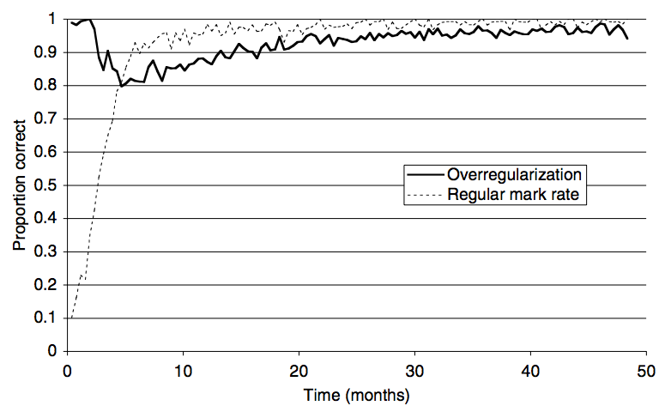
Results of the model
Successful
retrieval:
get sang
from memory
Irregular verbs
Regular verbs
Apply
-ed rule:
sanged
Apply
specialized
rule
sing
sang
Notes:
The time at which the –er rule is learned performance DECREASES for irregular verbs, but INCREASES for regular verbs
Overregularization=(irregular correct)/(irregular correct+irregular regularized)
Regular mark rate = (regular correct)/(regular correct + regular incorrect)

Slide 113
Past Tense Conclusions
The model solves some of the problems of the earlier models:
It can learn without feedback
It explains where the rules come from
Uses real input
The model also works in other languages, for example in learning the German plural
→ A simplified version of the model can be found in the ACT-R tutorial unit 7

Slide 114
5 $ 3 = ?
5 $ 3 = 5 + 4 + 3 = 12
Notes:
36 repetitions

Slide 115
Back to the pyramid task…
Production Compilation
Speedup because retrievals are no longer needed
It reduces errors (no retrieval errors), > 98% correct vs. 84% in phase I
It models discontinues learning (u-shape, discrete changes)

Slide 116
Today
Skill acquisition and production rules
Procedural Memory & Utility Learning
Learning new rules: Production Compilation
Black Jack Assignment

Slide 117
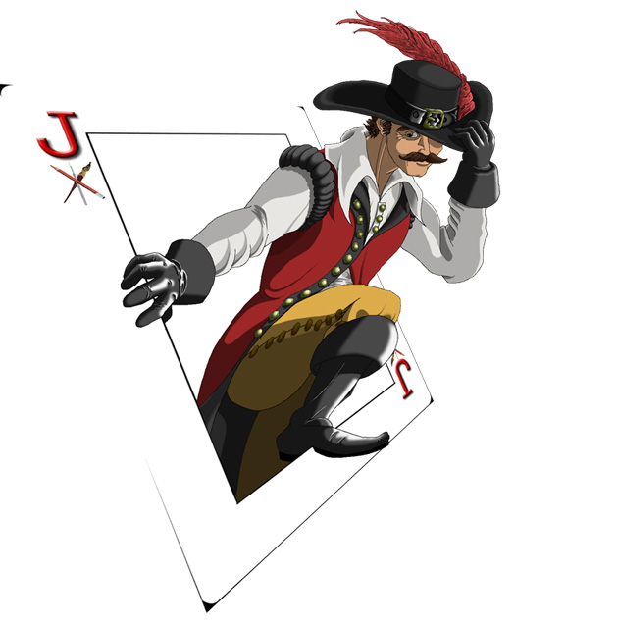
Assignment 4: 1-Card Blackjack

Slide 118
Instance-based learning for Blackjack
Model that does not ‘think’ about how to play blackjack, but learns from experience
Instance-based learning:
store experiences in declarative memory
retrieve similar situations

Slide 119
Remember the Sugar Factory?
Today?
Yesterday 2
Workers 7
Production 12
Yesterday 7
Workers ?
Goal Production 9
Partial Matching
8
8
9
2
7
12
3
8
12
5
5
5
Won!
Declarative Memory
Notes:
What do we need for this?

Slide 120
1-Card Blackjack
Blackjack with two players
Each player has a deck of cards
ranging between 1 and 10
unknown distribution and number of cards
Game consists of several ‘hands’ (default 100)
Goal of a hand: collect cards with a sum equal or less than 21, but more than the opponent
1 may be used as 1 or 11

Slide 121
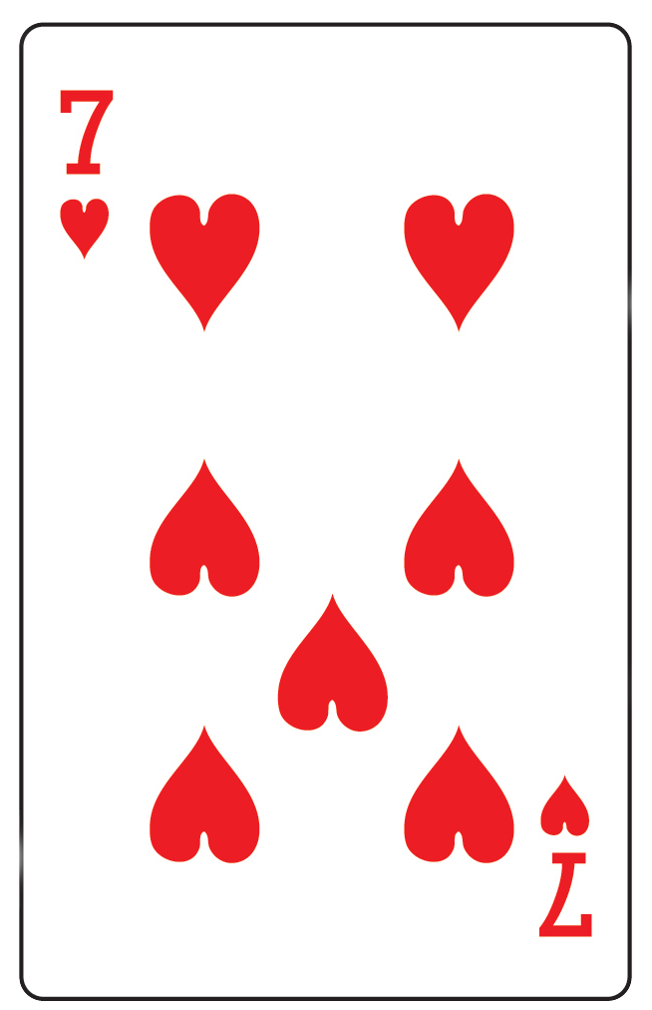
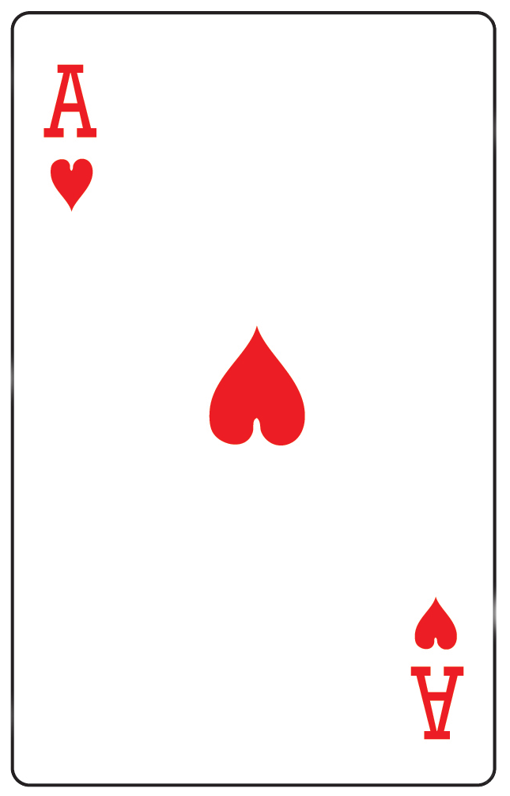
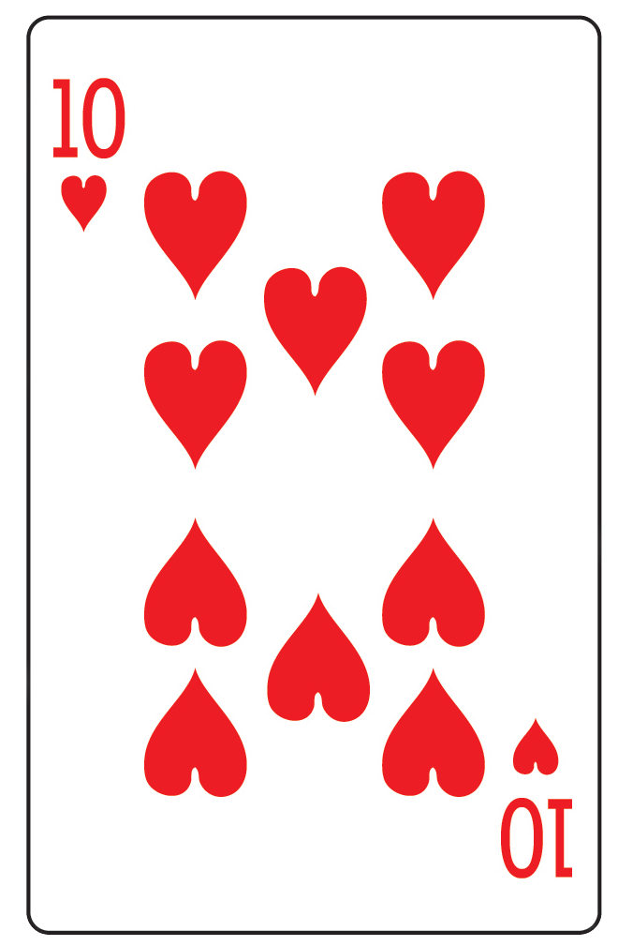
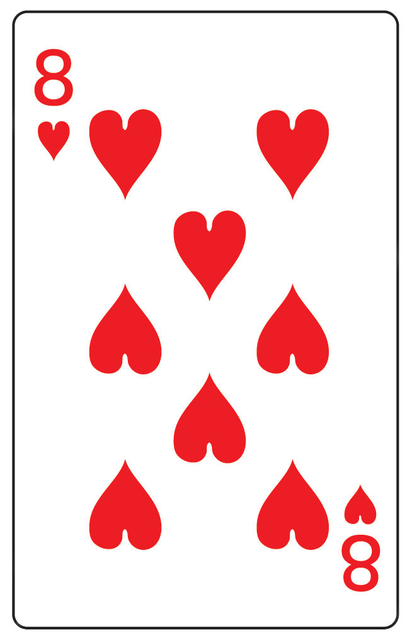
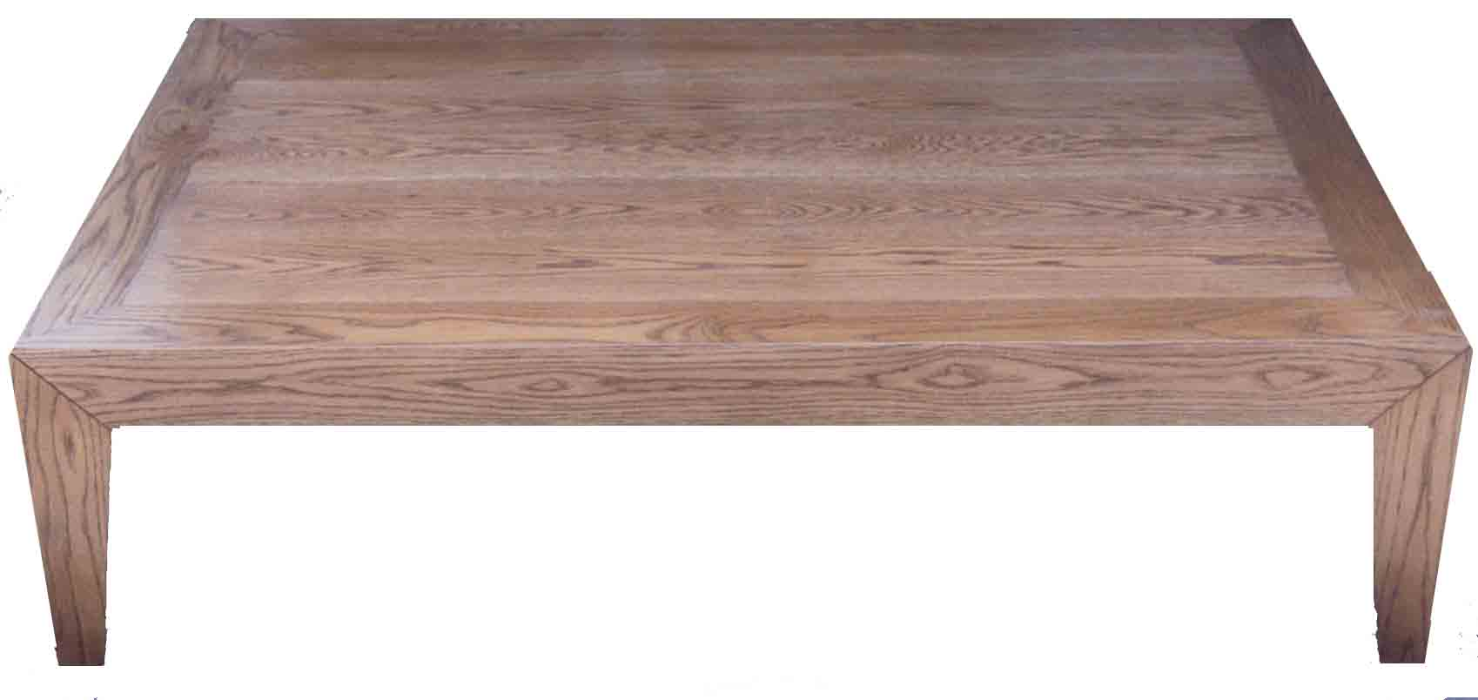
1-Card Blackjack
Stay!
Hit?
Notes:
Stay or hit?

Slide 122
1-Card Blackjack
Model knows rules, but has no experience
has to decide to hit or stay
can Win, Lose, or Bust (>21)
Opponent has a fixed strategy, your model needs to improve

Slide 123
No interface
Start of the Hand
End of the Hand
=goal>
isa game-state
mc1 1-10
mc2 1-10
mc3 nil
mstart mc1+mc2
mtot nil
mresult nil
oc1 1-10
oc2 nil
oc3 nil
ostart oc1
otot nil
oresult nil
state start
=goal>
isa game-state
mc1 1-10
mc2 1-10
mc3 nil or 1-10
mstart mc1+mc2
mtot mc1+mc2+mc3
mresult win/lose/bust
oc1 1-10
oc2 1-10
oc3 nil or 1-10
ostart oc1
otot oc1+oc2+oc3
oresult win/lose/bust
state done
model’s cards
model’s result
opponent’s
cards
opponent’s
result
Notes:
No interface, all info provided in goal
Start hand: start info
End hand: outcome

Slide 124
Starting Model
Partial matching
If it retrieves something, it does as retrieval, otherwise stays
Learns new chunk with what it should have done
+retrieval>
isa learned-info
mc1 =c

Slide 125
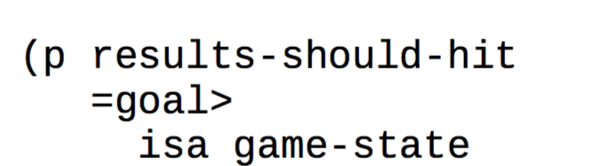
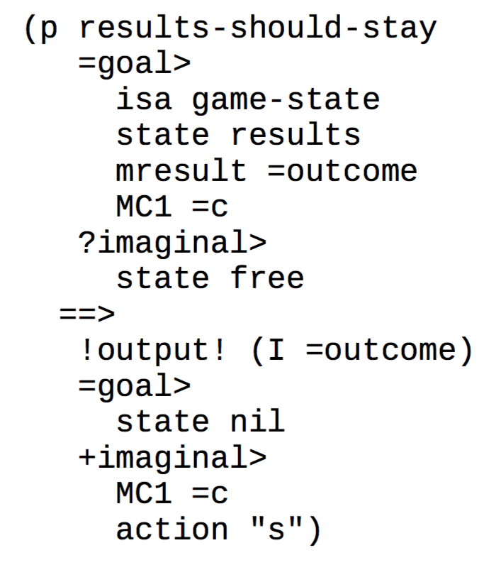
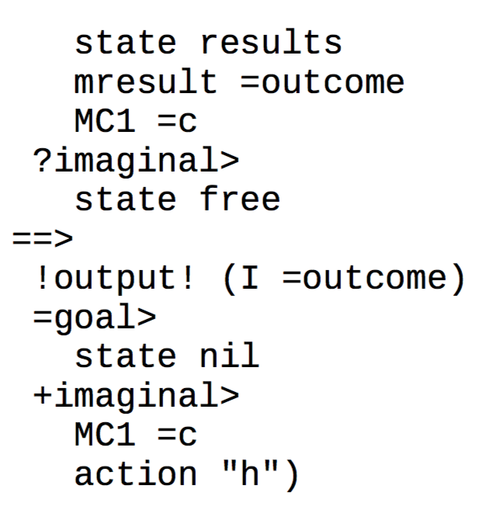
Learns what it should have done
(spp results-should-hit :u 10)

Slide 126
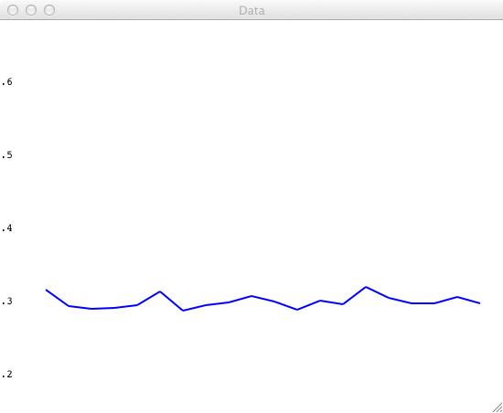
Starting Model
~ 30%

Slide 127
Improvement 1: Hit Tests
add tests
Make different rules for winning, losing and busting!

Slide 128
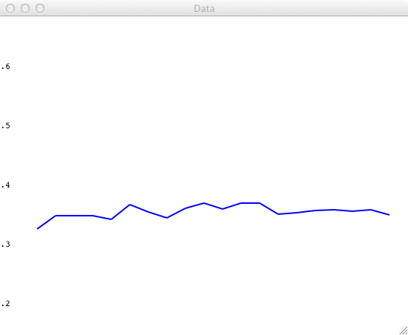
Improvement 1: Hit Tests
Starting Model
Improved Hit Tests
~ 36%
~ 30%

Slide 129
Improvement 2: Features & Retrieval
(p results-should-hit
=goal>
isa game-state
state results
mresult =outcome
MC1 =c
add features-for-dm
=imaginal>
isa learned-info
==>
!output! (I =outcome)
=imaginal>
MC1 =c
action "h”
new-feature =new
new2 =new2
-imaginal>
)
(chunk-type learned-info …)
(p start …

Slide 130
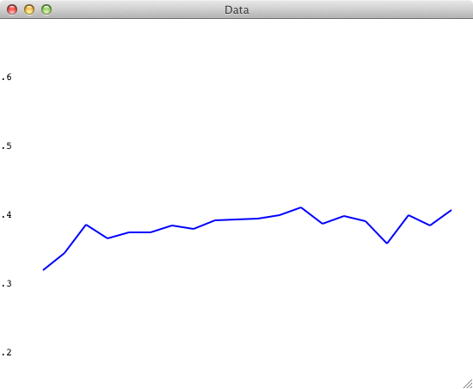
Improvement 2: Features & Retrieval
Improved Hit Tests
Improved Features & Retrieval
~ 39%
~ 36%
My best is 40% so far…

Slide 131
Assignment 4: Blackjack Tournament
All models are going to play against each other, so your model has to be general enough to deal with different opponents!

Slide 132
Different Opponents
Default game:
Normal deck
Opponent: Stays with >14, hits otherwise
Random strategy: 32% wins
Optimal: 46% wins
Reference model: 40%
Aim at >36% wins
For the tournament, your model should be general enough to win against different opponents:
extra_games_blackjack.txt (Brightspace)
(show-learning 200 t ‘game2 )
Game 2, 3, 4, 5
Note: 21 might not be the winning number!

Slide 133
Good luck!

